Slide 1
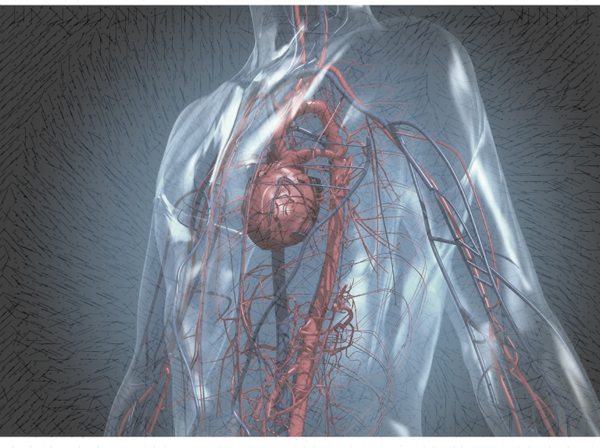
Introduction
Cardiovascular disease is one of the biggest health risks that may lead to complications. 80% of deaths are caused by heart disease. Therefore, its causative factors must be understood, with the cardiovascular disease dataset consisting of several features, including target variables for the presence or absence of cardiovascular disease. We will study features that have a high and direct effect on cardiovascular disease.

Slide 2
Data Structure
The dataset contains 70,000 observations and 13 features, including Objective Features (Age, Height, Weight, Gender), Examination Features (Systolic blood pressure, Diastolic blood pressure, Cholesterol, Glucose), and Subjective Features (Smoking, alcohol intake, as well as a Subjective Feature that includes Physical activity and Target Variable: Presence or absence of cardiovascular disease
N | id | age (days) | gender | height (cm) | Weight (kg) | ap_hi | ap_lo | cholesterol | gluc | smoke | alco | active | Y(cardio )
1 | 0 | 18393 | 2 | 168 | 62.0 | 110 | 80 | 1 | 1 | 0 | 0 | 1 | 0
2 | 1 | 20228 | 1 | 156 | 85.0 | 140 | 90 | 3 | 1 | 0 | 0 | 1 | 1
3 | 2 | 18857 | 1 | 165 | 64.0 | 130 | 70 | 3 | 1 | 0 | 0 | 0 | 1
… | … | … | … | … | … | … | … | … | … | … | … | … | …
70000 | 99999 | 20540 | 1 | 170 | 72.0 | 120 | 80 | 2 | 1 | 0 | 0 | 1 | 0
cholesterol | 1: normal, 2: above normal, 3: well above normal gluc | 1: normal, 2: above normal, 3: well above normal

Slide 3
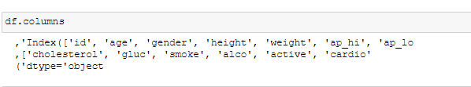
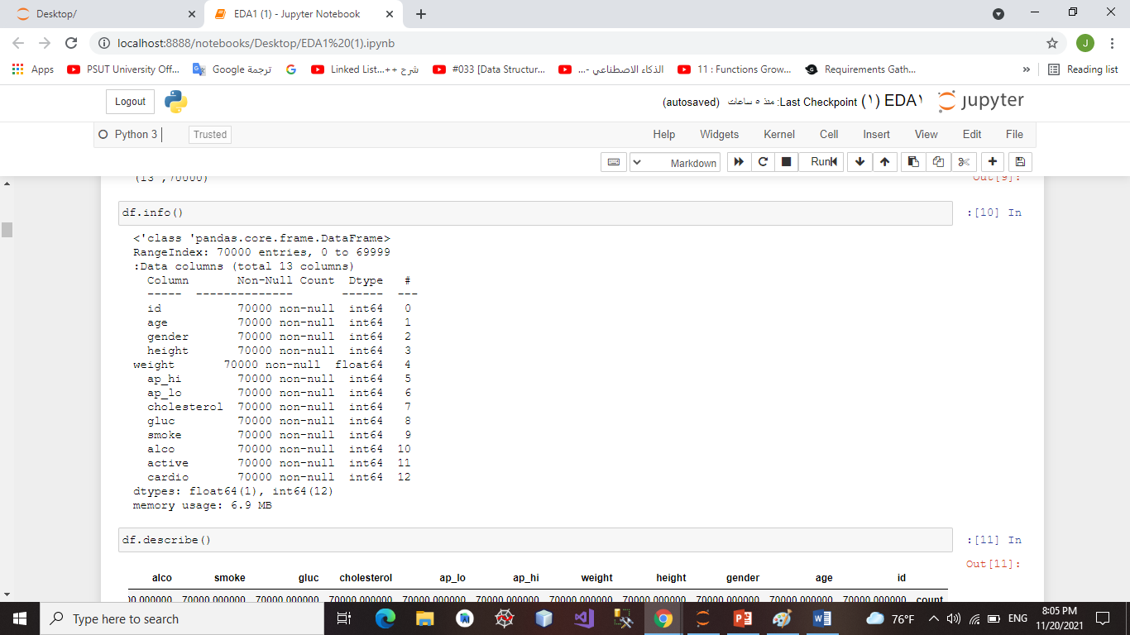
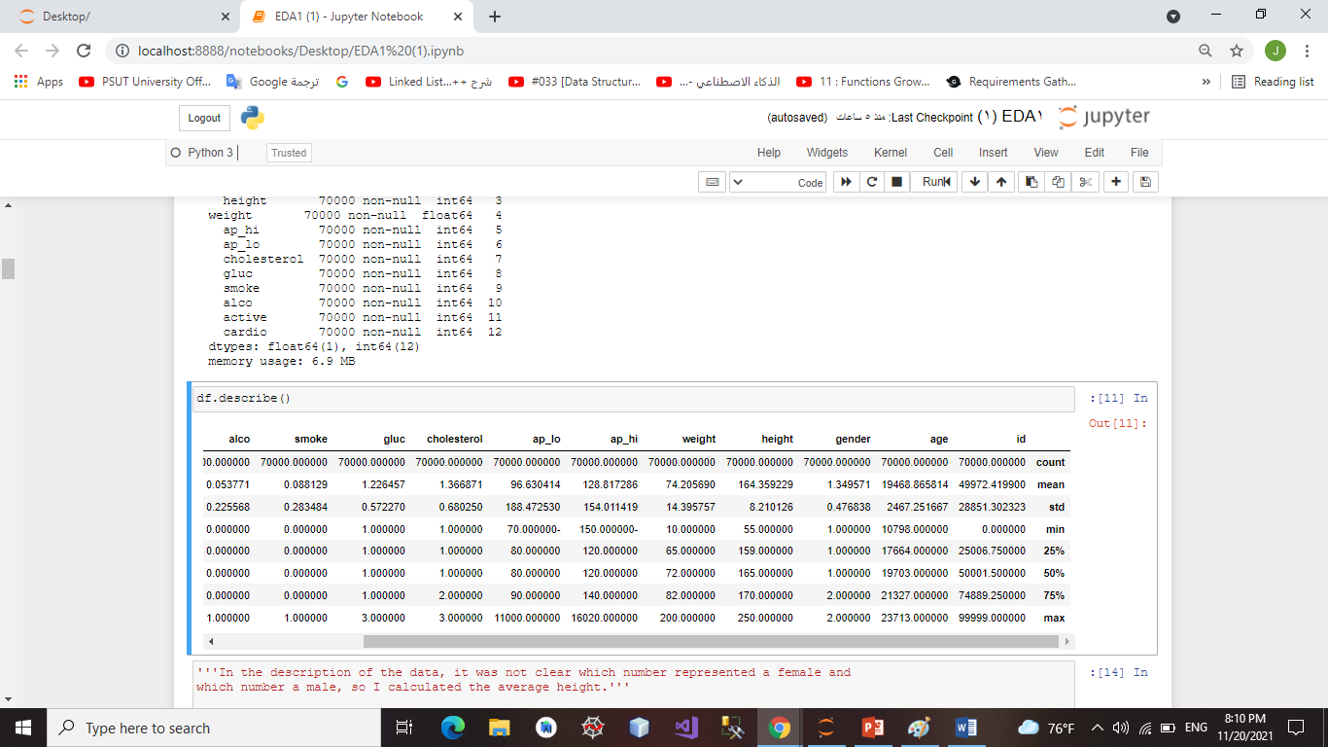
Data Structure

Slide 4
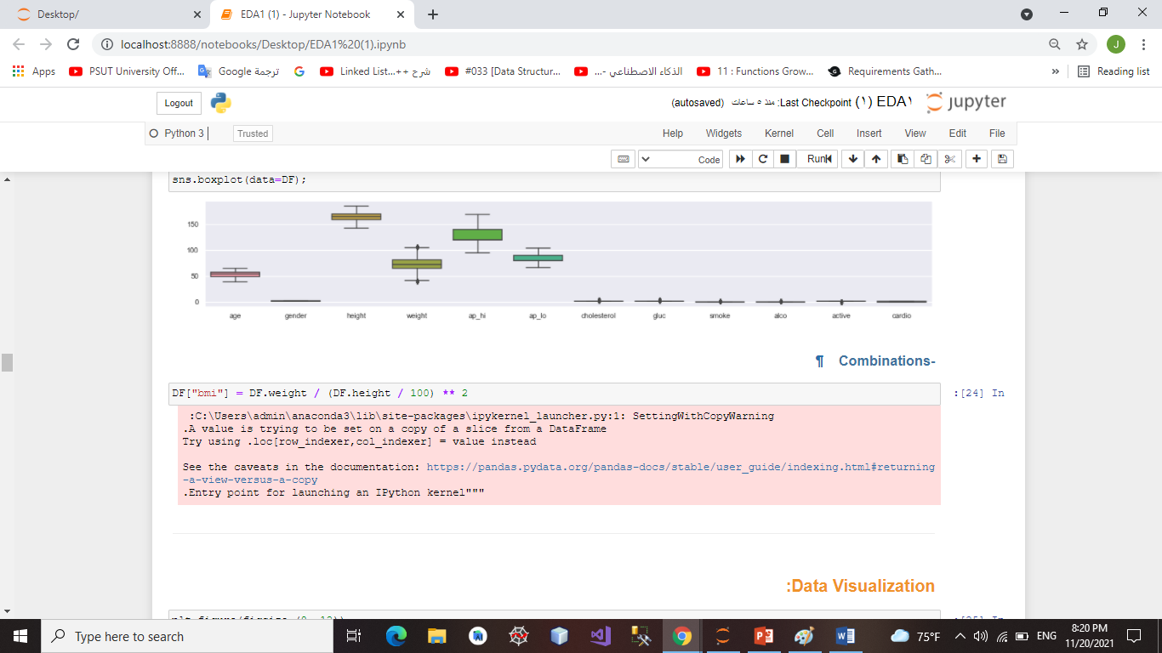
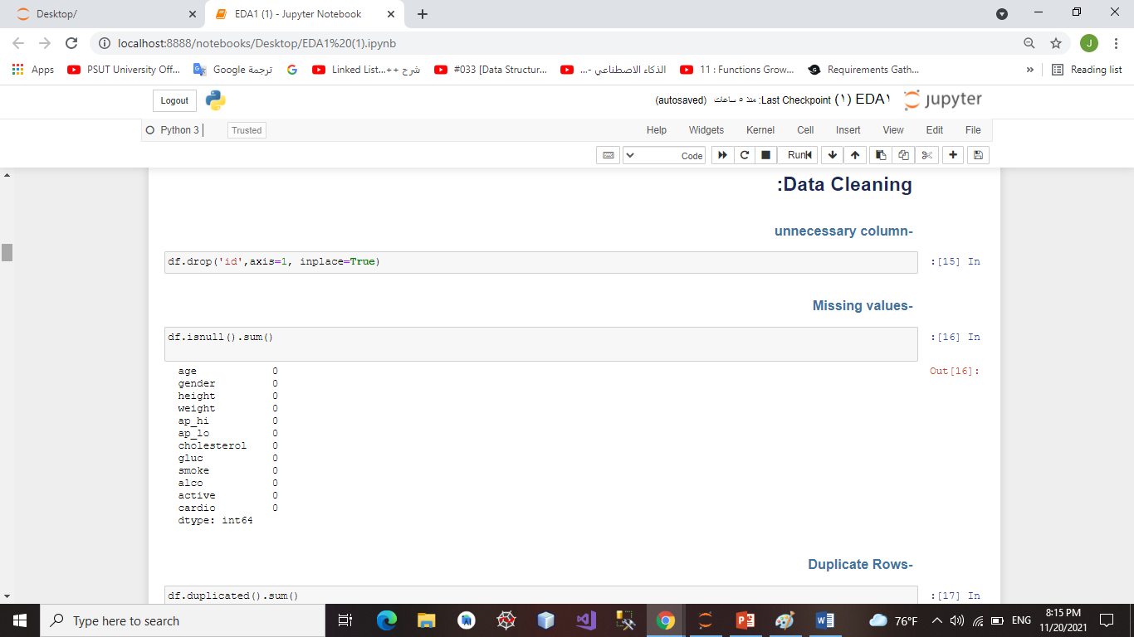
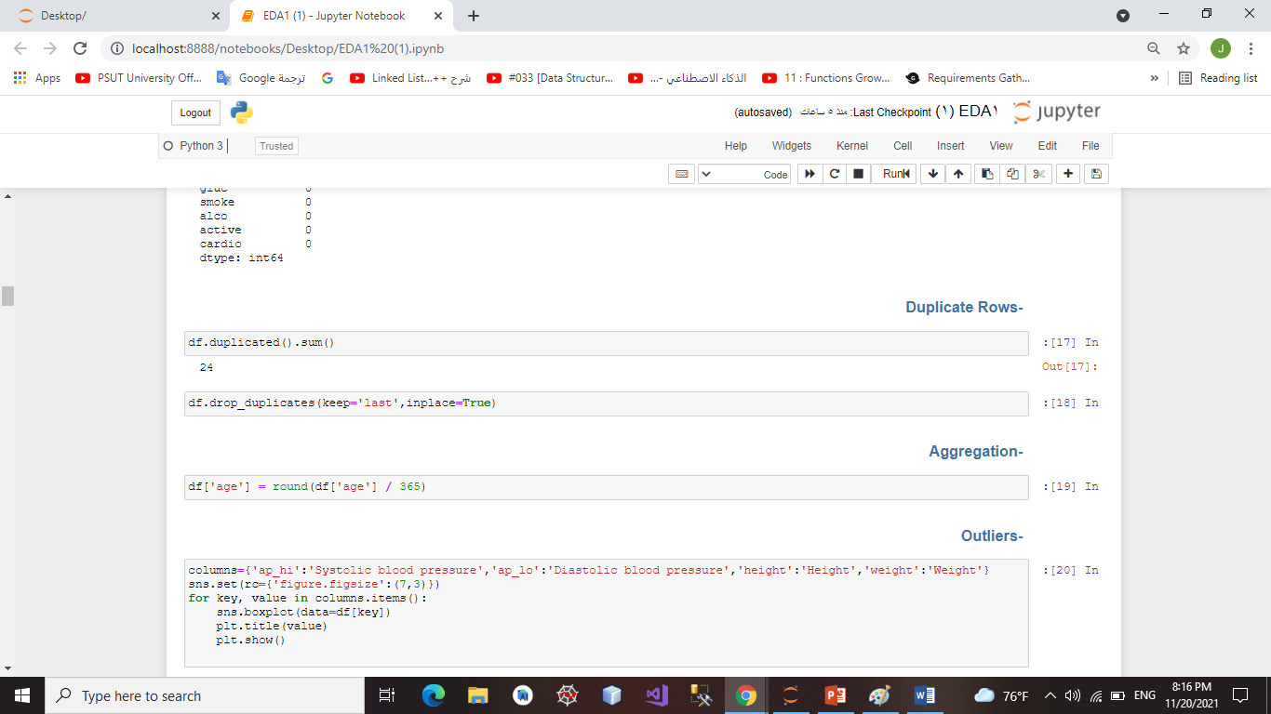
Data Cleaning

Slide 5
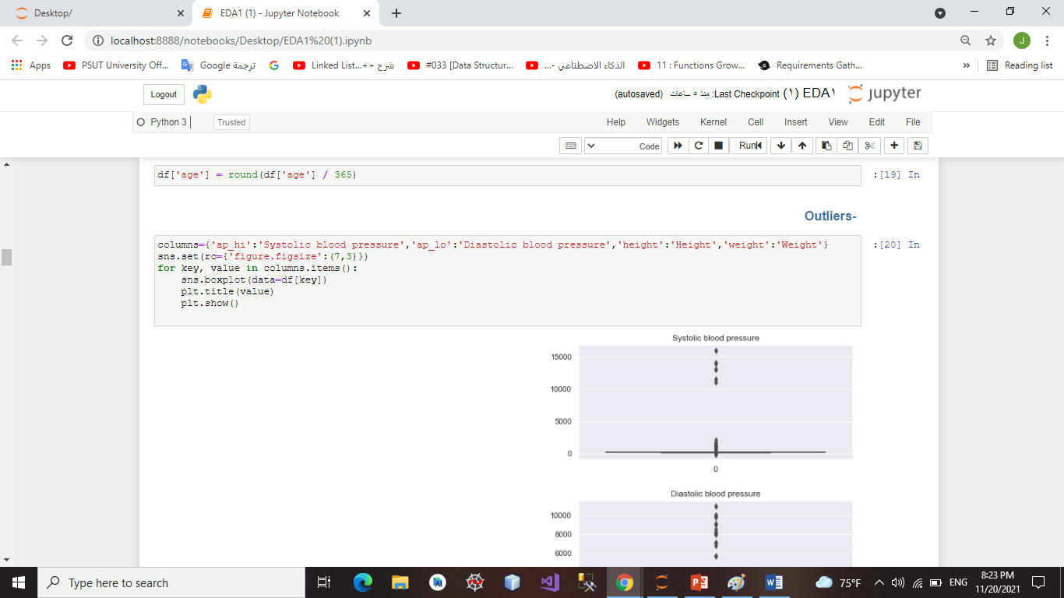
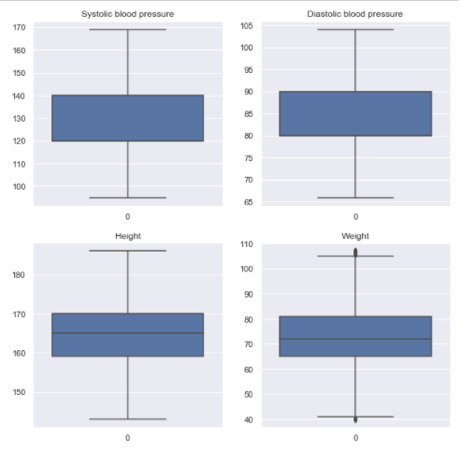
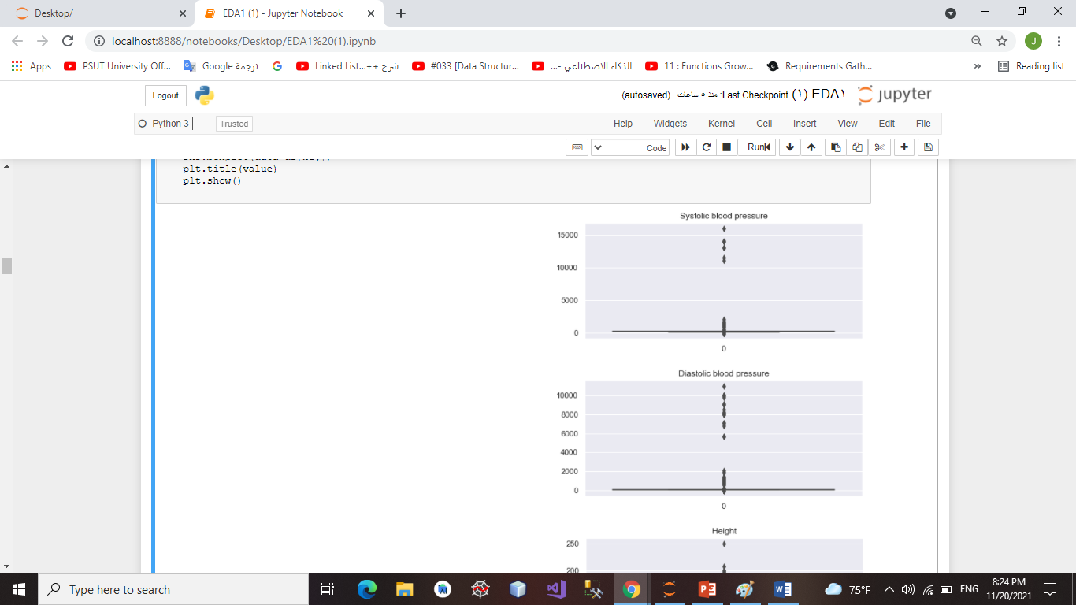
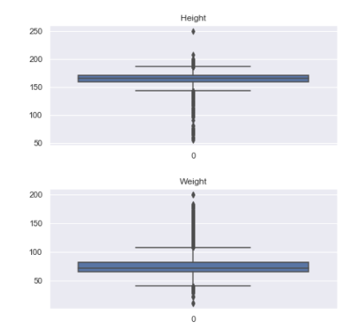
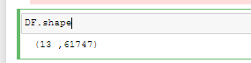
Data Cleaning
Remove outliers

Slide 6
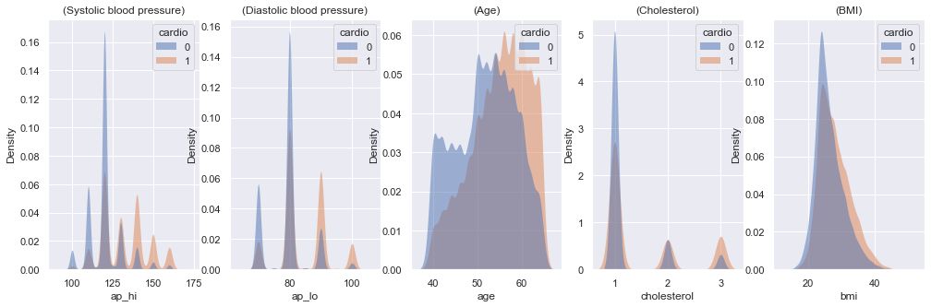
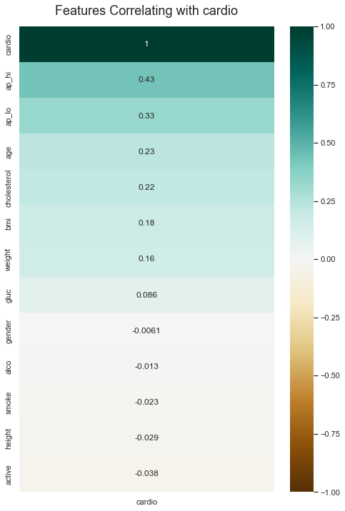
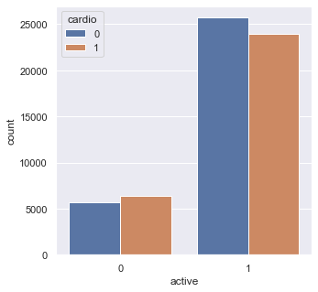
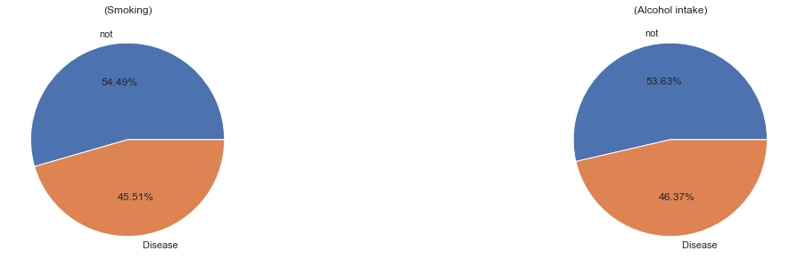
Data Analysis
Positive Correlation
Negative Correlation

Slide 7
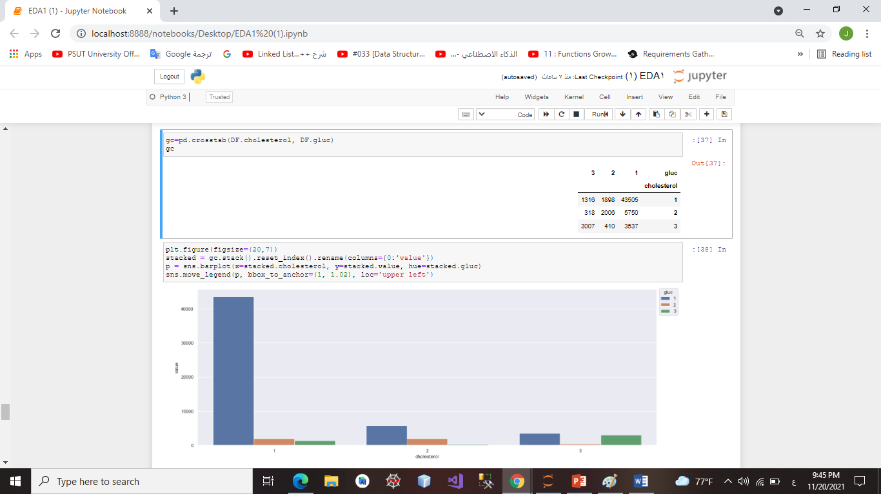
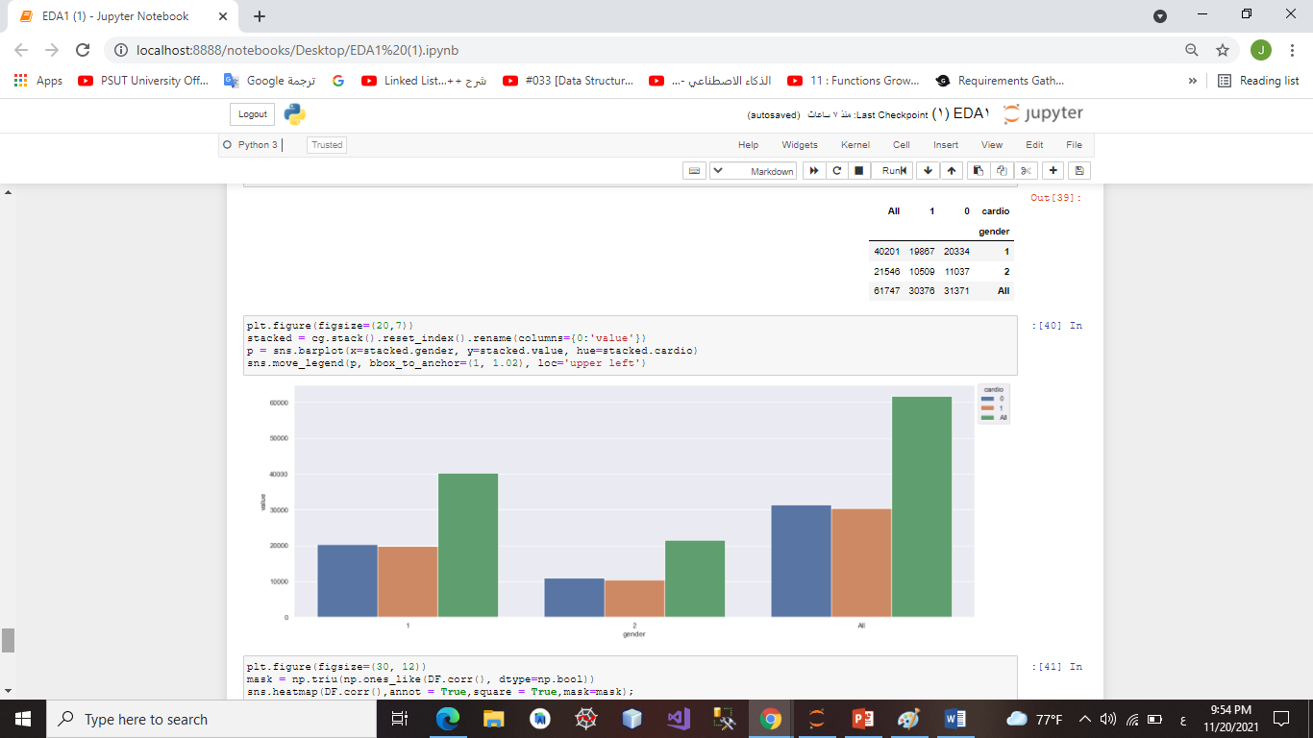
Data Analysis
Glucose has a low correlation value, but it has a high correlation value with cholesterol
Gender is not an important feature, but we can study the prevalence of cardiovascular disease.

Slide 8
Conclusion
-Systolic blood pressure represents the greatest effect on the occurrence of the disease. When it reaches 140 and above, the incidence of the disease increases. As for diastolic blood pressure, when it reaches approximately 90, the incidence of the disease is high.
-The higher the age and bmi, the greater the risk of disease.
-The higher the age, BMI, and cholesterol, the higher the risk of disease.
-Glucose has a high impact on cholesterol.
-50% of smokers and alcoholics are at risk of developing the disease.
-active has an inverse relationship with the disease, but the analysis was not accurate about it because it classified people into active and non-active, and this classification is not accurate because active has levels.
-All of these analyses are close to those published on heart disease, which demonstrates the power of data analysis to extract information.

